Slide 1

Safest path through Corona affected regions
Sameera Turupu | Sravya Kambhampati
Aditya Bhamidipati | Avinash Bondalapati
Notes:
Coronavirus has the devastating impact on the lives of people.
Right now the mortality rate estimate according to World health Organization is 3.4%
Because of the mandate quarantine, travelling has become a major problem. But in some emergencies, travel is unavoidable
Good Morning everyone, sameera, sravya, avinash and I worked on determining the safest path through corona affected regions in case of emergency travels

Slide 2
Motivation
Travel during the COVID-19 outbreak is not entirely risk-free.
Unavoidable situations propel us to travel.
Difficult to keep track of epicenters while travelling
Ease the users travel with safety
Notes:
No one can tell that traveling during the coronavirus outbreak is entirely risk-free, regardless of your age, health, or travel destination.
Unavoidable situations propel us to travel, and while we travel, we will have to take necessary measures not to get affected
Also, it is difficult to keep track of all dangerous region during travel
Our project main motto is to Ease the users travel using faster algorithms that can give us the safer paths based on source, destination, feasibility and dynamic COVID 19 information

Slide 3
Next Steps
Problem Formulation
Model Parameters
Algorithms
Implementation Details
Results
Technology Stack
Future Scope
References
Collaboration
Notes:
Moving forward we will be discussing the problem formulations, model parameters which is input descriptions and algorithms followed by implementation details and finally visualizations
Sameera will continue with the problem formulation

Slide 4
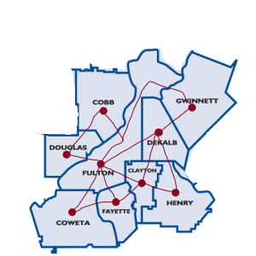
Problem formulation – Offline, deadline
Frozen Data
Safest path
Time information from google maps
Deadline
Path variance based on time constraint
Alternative faster path when deadline not met
Density = (Confirmed Cases in a region)/Population
Safest path = min (ΣDensity * time)
Notes:
Hi all, Coming to problem formulations
There are 3 problem formulations that we have considered. offline, deadline and online
The offline scenario is implemented on both the algorithms Dijkstra and A* which will be discussed later in the presentation. The basic idea for this implementation is to take static COVID information of Atlanta and finding the safest path from source to destination I.e, between the counties. As you can see the following map we have 9 counties represented as 9 graph vertices and the path between them as edges. The input information will be detailed more in the further slides
We have defined the parameter density for the affected region which gives us an idea of how badly the region is affected which is calculated to be confirmed cases in a region divided by population of that region.
Finally, safest path is determined to be minimum summation of density and time over the region of travel
The consideration for time here is close to real world and the information is gathered from google maps
We have also covered the deadline scenario in offline where there is a constraint to reach the destination in a speculated time,
Here, the path from source to destination is calculated based on the time conditions and if in case, the travel is impossible within the deadline, an alternative faster path is suggested

Slide 5
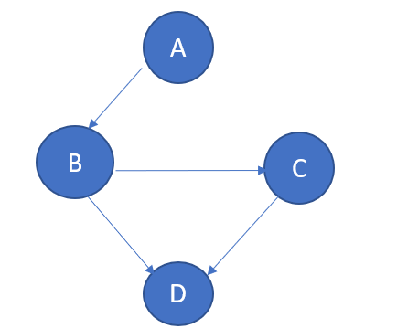
Problem formulation – online
Dynamic data
A* algorithm
Dynamic Heuristic
Path decision is dependent on updated heuristics for every 30 mins
Example A(Source) -> D(Destination)
Heuristic update at B
Better to take path B -> D rather than B -> C -> D
Then user prefers path B -> D
Notes:
The online scenario is a simulation of real time lookup of COVID information. This is implemented on A* algorithm.
The idea of online A* means that the heuristic parameter is changing by the time. The user path decision will then depend on the updated heuristic for every 30 mins.
Suppose for example we have a path A -> B -> C -> D. User starts at A and has to reach the destination D.
Once he reaches B he can lookup for updated heuristics describing latest COVID information and then take decision at B whether to go B -> D or B -> C -> D
Avinash will be continuing with the model parameters

Slide 6
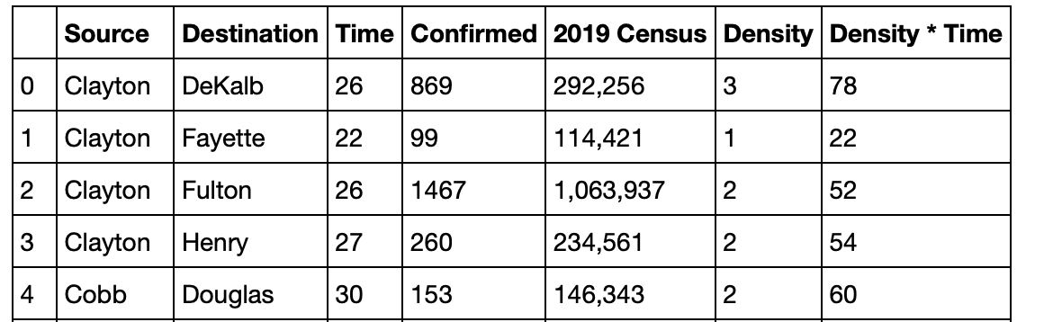
Model Parameters
Selected a set of 9 counties which are in and around Atlanta for our model and obtained census information for these 9 counties.
COVID-19 confirmed cases count from Johns Hopkins dashboard.
Using the above information we got density value where we define density as confirmed/population for a county.
Notes:
Hello eveyrone, for model parameters I.e input descriptions
We have selected few counties in and around Atlanta, while we initially considered the total counties in Georgia. The data collection for 159 counties wouldn't be possible for the given time frame. So we chose these 9 counties.
We got the census information of these 9 counties which will be helpful in calculating the density of the affected people.
Johns Hopkins university which tracked the progression of virus from earlier status provided information on the number of confirmed cases in each of the counties. This being a trusted source, we chose this as our source for confirmed cases count.
Now using the confirmed cases and population we get the density value which we use as a parameter to gauge the situation. The higher the density, the more risk of being affected and vise versa. To make it easier to understand we have multiplied density value with 1000 to get a density value greater than 1.
Sravya will continue with Dijkstra algo.

Slide 7
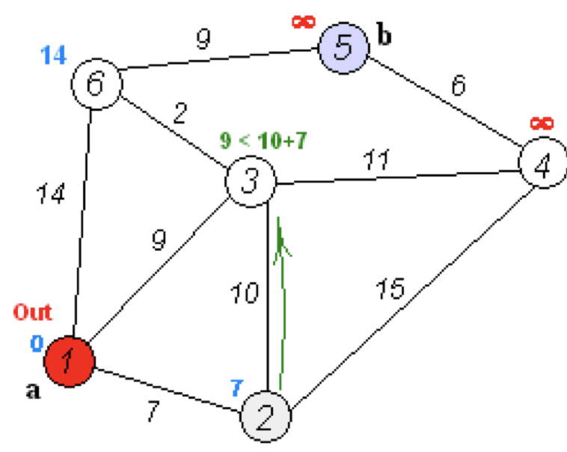
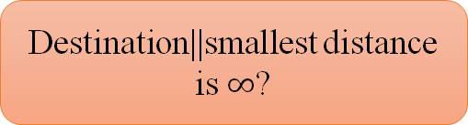
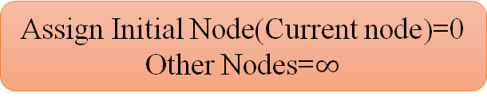
Dijkstra's algorithm
Unvisited Nodes
Assign Initial Node(Current node)=0
Other Nodes=$∞$
Current node=Unvisited node with min distance
Newly calculated distance>assigned? Assigned: New dist
Dist(Unvisited neighbors for current node through current node)
Mark current node=visited
Unvisited Nodes=Unvisited Nodes-current node
Destination||smallest distance is $∞$?
No
Yes
STOP
Notes:
We used Dijkstra’s algorithm to find safest and shortest path between source and destination.
Lets discuss how the algorithm works briefly.
It starts with marking all nodes unvisited.
Next step is to assign distance 0 to initial node which is a source here and infinity to all other nodes.
Followed by selecting the unvisited node with the smallest distance and making it as our current node.
Then it finds unvisited neighbors of our current node and calculates their distance through current node and compares it with previously assigned distances and saves the smaller one.
For example here in this figure.. node 3 previously assigned value is 9 and newly calculated distance through our current node is 17. So here we save previous value 9.
We then mark the current node as visited and remove it from the unvisited set.
We will stop this if destination is reached or if the smallest distance among the unvisited nodes is infinite. Otherwise, We, will repeat this from here again.

Slide 8
Dijkstra’s Advantages and Disadvantages
Finds shortest path to every single reachable node provided the graph doesn’t change.
Saved results can be used again without re-running algorithm.
Could achieve major speedup by switching to A*
Notes:
The main advantage of dijkstras algorithm is rather than just finding the shortest path from starting node to another specific node, this algorithm finds the shortest path to every single reachable node provided the graph doesn’t change.
As it runs until all of the reachable nodes are visited, we need to run Dijkstras algorithm only once and saved results can be used again and again without rerunning algorithm unless the graph changed.
Here we can see difference between Dijkstras and A* which is another algorithm we used to find shortest path. Dijkstra’s algorithm has to explore in all directions because it finds shortest path to every single reachable node whereas A* is exploring just towards goal.
Avinash will continue with dijkstras implementation

Slide 9
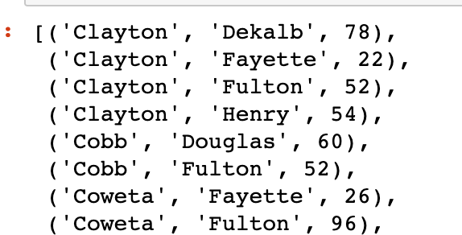
Dijkstra’s Implementation
Make use of the density values and travel time as a means of measure to calculate best possible path.
Using the calculated values we create a mapping where we get the cost associated with travel from one county to another.
Notes:
NOw coming for implementation details
We have used Dijkstra algorithm to find the shortest and safest path based on the obtained density values.
The input that we provide for Dijkstra algorithm is list of records where each record has a county, its neighbours and the density * time it takes to travel from this county to its neighbours. This value is used as the measure to identify the possible path by dijkstra algorithm.
Suppose we have a record with clayton, dekalb and value of 78. Here county is clayton and dekalb is its neighbour and 78 is the time * density value for reaching Dekalb.
we are using a simple Dijkstra algorithm to find the shortest path using the density * time values. This helps in finding the safest possible path available by making use of the time and density values combined. Thus by providing a safest path which is reasonable on both time and is safer.

Slide 10
Dijkstra contd...
To find the path, we need to specify two counties - source and destination to the algorithm.
Based on the input, we get a safest path or an empty string. But in our case safest path is always possible as the graph is connected.
For input "Cobb" and "Cowetta", we get Cobb Fulton Cowetta as the safest path.
Notes:
Now for the input to our Dijkstra algorithm we have designed it such that it accepts a source and a destination. Based on the already calculated values of Time * density values we try to find the safest path available.
we either get a safest path between source and destination or an empty string representing no path between the two counties.
For the sample input if we provide source as cobb and cowetta as destination, there any many paths possible between these two counties, based on the density * time values, the value at fulton is smaller than density * time value at Douglas , so the path chosen goes through fulton rather than doughlas.

Slide 11
Dijkstra – with deadline condition
Given a deadline condition, return a safest possible path satisfying the deadline condition.
Can be helpful when a person running short on time or emergency.
Doesn't consider the number of confirmed cases while calculating path.
If no path is found, suggests next best possible path.
Notes:
Given. A deadline condition lets say the time limit, we need to find the safest possible path that satisfies the given deadline condition.
For this deadline condition scenario, the task or the problem is to find the path in the given time frame. So we find the safest path first by considering the density values and if the safest path obtained is costlier or doesn’t satisfy the deadline condition, then we consider only the time and find the shortest path.
Based on the given deadline value, sometimes a path might not be possible, for example if we say that we need to travel from cowetta to gwinnett in 10 mins it wouldn't be possible as it takes aleast an hour. In this case we suggest user with next best route available.
This will be helpful when a person is running short on time or its an emergency and want to reach destination quickly without considering the number of COVID-19 confirmed cases along the path.

Slide 12
Dijkstra – (deadline) continued...
Dijkstra with deadline condition reduces to finding shortest path between counties with travel time as weights.
Returns a path satisfying deadline condition or next best available path.
Deque contains the safest available path.
Time Complexity of Dijkstra's Algorithm is O ( V ^2 ) but with min-priority queue it drops down to O ( V + E l o g V )
Notes:
When we consider deadline condition and try to find the shortest path between two counties, then its been reduced to a simple finding shortest path algorithm with time values as weights in the graph. This can be solved by any shortest path finding algorithm. We have used Dijkstra algorithm only with input having travel times.
For the given input we will try to find the safest path that satisfies the deadline conditions and if a path is found we return that else we return the next available path I.e the safest path available between those two counties with shortest minimum time taken. This path will be best available option between those two counties and there will be no other path that takes less time than this path.
We used deque in implementation of Dijkstra algorithm. First we start with the source node in it and at any given point deque will have the best possible path till that point of time. At the end deque will have the safest path available in it.
Time Complexity of Dijkstra's Algorithm is O ( V 2 ) but with min-priority queue it drops down to O ( V + E l o g V ) . Here if we were to find the safest path between all pairs of counties, then use of Dijkstra could be costly. But for finding a single safest path between two counties Dijkstra algorithm is in reasonable time complexity.
Sameera will continue

Slide 13
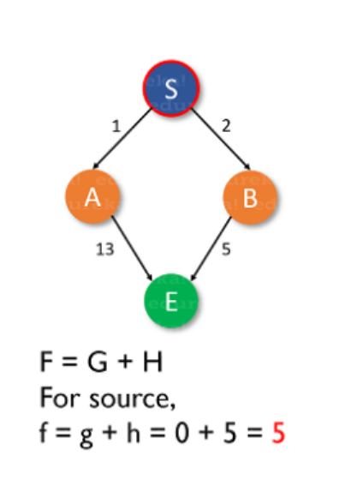
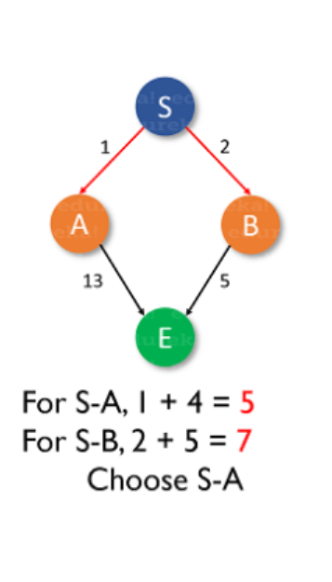
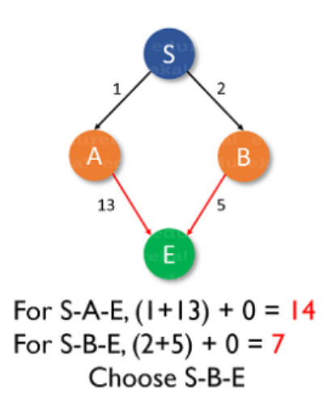
A* Algorithm
Place Start node
Calculate cost function
F(n) = g(n) + h(n)
Save the index of the node with smallest f value
target node
Yes
Terminate
No
Heuristics:
S->5
A->4
B->5
E->0
Delete all the successors of node
Calculate f(n)
Notes:
A* is an Informed search algorithm, or a best-first search, meaning that it is formulated in terms of weighted graphs: starting from a specific starting node of a graph, it aims to find a path to the given goal node having the smallest cost
A* algorithm is both optimal and complete -> Optimal meaning that A* is sure to find the least cost and Complete meaning that it is going to find all the paths that are available to us from the source to the destination.
At each iteration of its main loop, A* needs to determine which of its paths to extend.
It evaluates nodes by combining g(n), the cost to reach the node, and h(n), the cost to get from the node to the goal: f(n) = g(n) + h(n) . Since g(n) gives the path cost from the start node to node n, and h(n) is the estimated cost of the cheapest path from n to the goal, we have f(n) = estimated cost of the cheapest solution through n .
Considering the above example, we start with source S and must reach the destination E. The estimated heuristics are considered. Using the formula we have chosen S-B-E as the final path instead of S-A-E
Advantages and Disadvantages: A* is slow and the space it requires is a lot as it saves all the possible paths that are available to us. This makes other faster algorithms have an upper hand over A* but it is nevertheless, one of the best algorithms because It knows which is the best path that can be taken from its current state based on heuristics unlike dijikstra

Slide 14
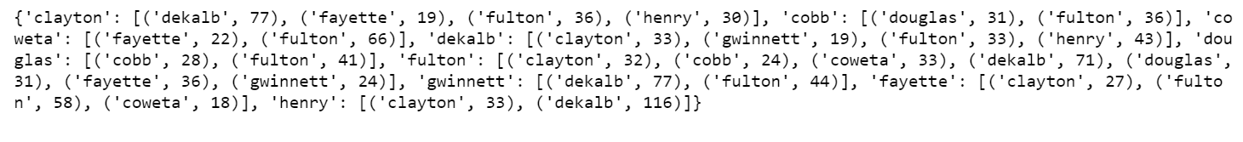
A* implementation
Input: Dictionary of counties, their neighbors and weight information
Weight information -> density * time to reach that region
*Source: https://github.com/CSSEGISandData/COVID-19/tree/master/csse_covid_19_data/csse_covid_19_daily_reports
Heuristic information
It is the product of density and time for a region.
Initial heuristics are based on the input data.
Notes:
The source for the algorithm is from the data repository for the 2019 Novel Coronavirus Visual Dashboard operated by the Johns Hopkins University Center
The input for the algorithm is designed to be a dictionary of counties holding the information about its neighboring counties and an estimated weight information calculated as a product of density(representing how dangerous a region is) and time to reach that county(estimated time with the help of google maps)
Also takes in the source and destination values as input
Starting from the source county -> this algorithm checks for the neighboring counties and finds the least cost f value and makes it as a checkpoint.

Slide 15
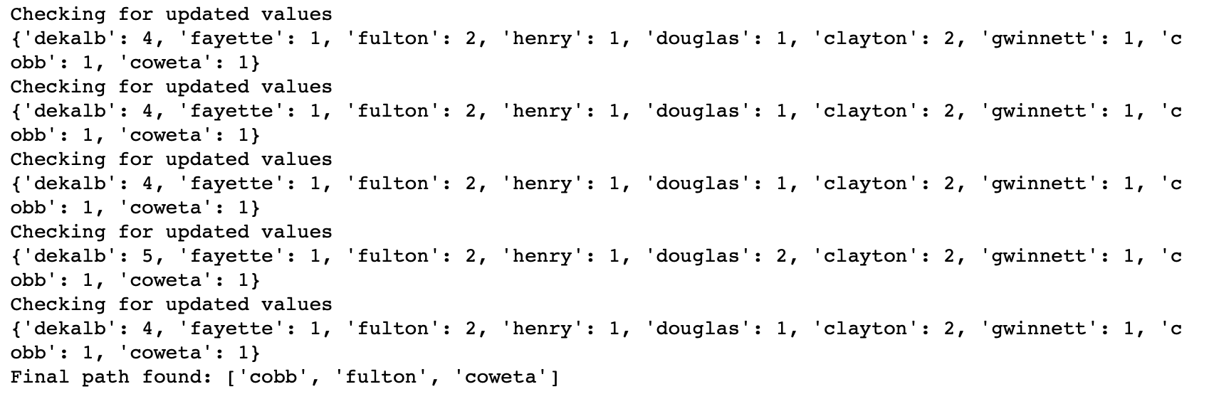
A* Algorithm Contd..
Online implementation through following:
Simulating time <-> Program sleep
Realtime lookup <-> history information (Because COVID information is updated daily rather than hourly)
Time Complexity - O(log⁡h∗(x)) where x = weight and h = heuristic
Notes:
We have implemented A* as an online algorithm
Here we mocked the scenario of an updated COVID information for every 30 mins by making the program sleep and fetch updated values. The updated values as taken as history information for now because the data sources updated daily instead of hourly. In this way we update the heuristic values,
Now when the algorithm resumes, updated heuristics are used in determining the rest of the path. We can observe from ouput that the heuristic value of douglas has increased after 3 iteration implying that it has become a more susceptible path for infection.
This continues till the destination is reached and at every vertex updated heuristics are picked up. And path changes occur accordingly.
The algorithm can also be implemented using Offline information -> based on the frozen heuristic data. Which means that there will be No updates for the heuristics => no updates for paths.
The time complexity is polynomial when the search space is a tree =O(log⁡h∗(x)), where h is heuristics and x is the weight

Slide 16
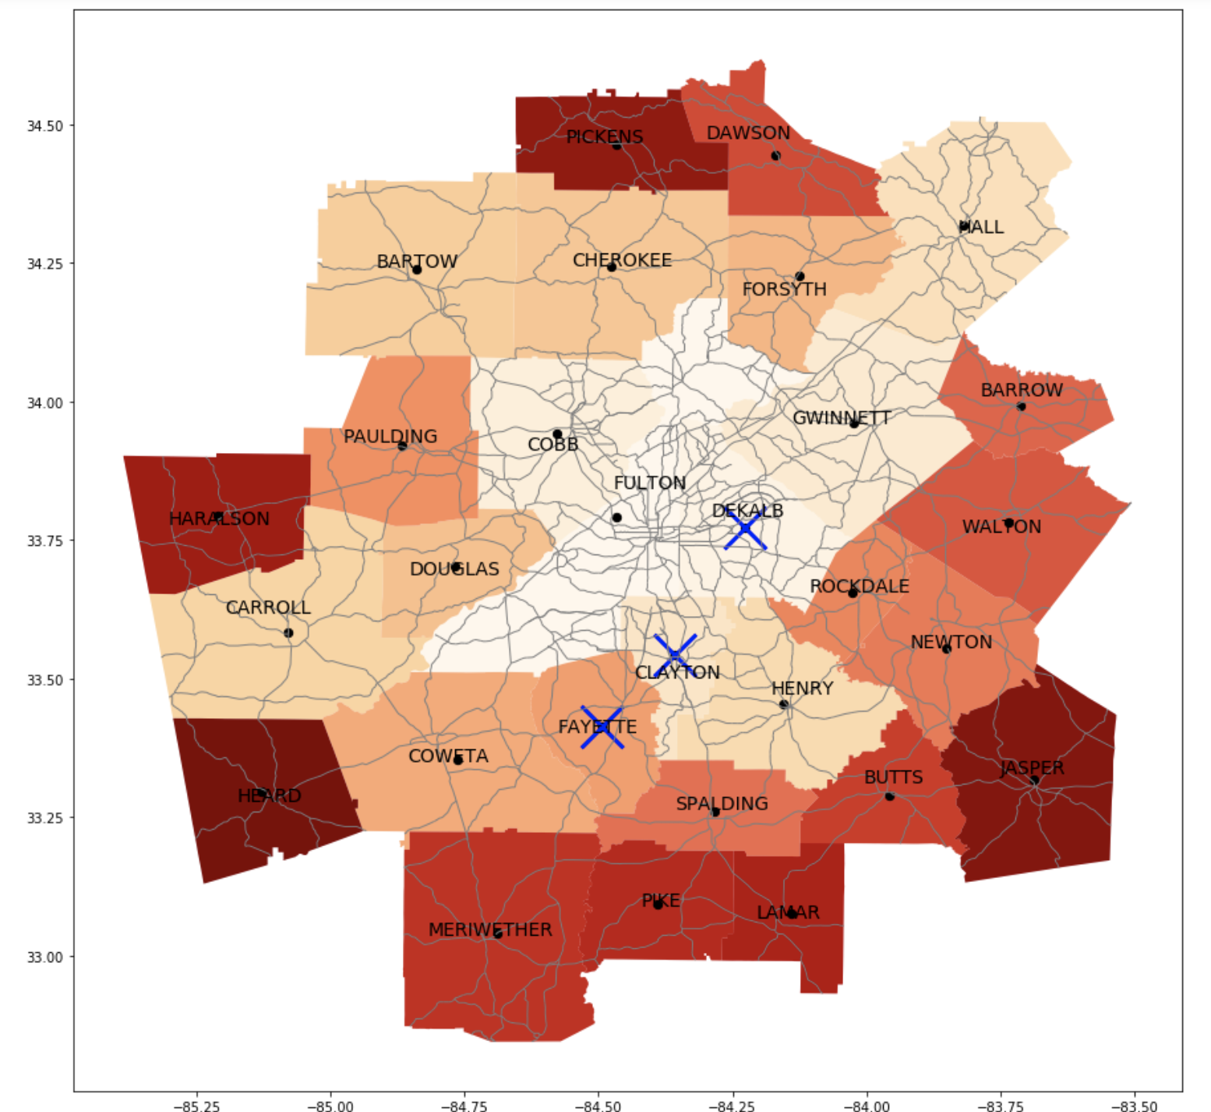
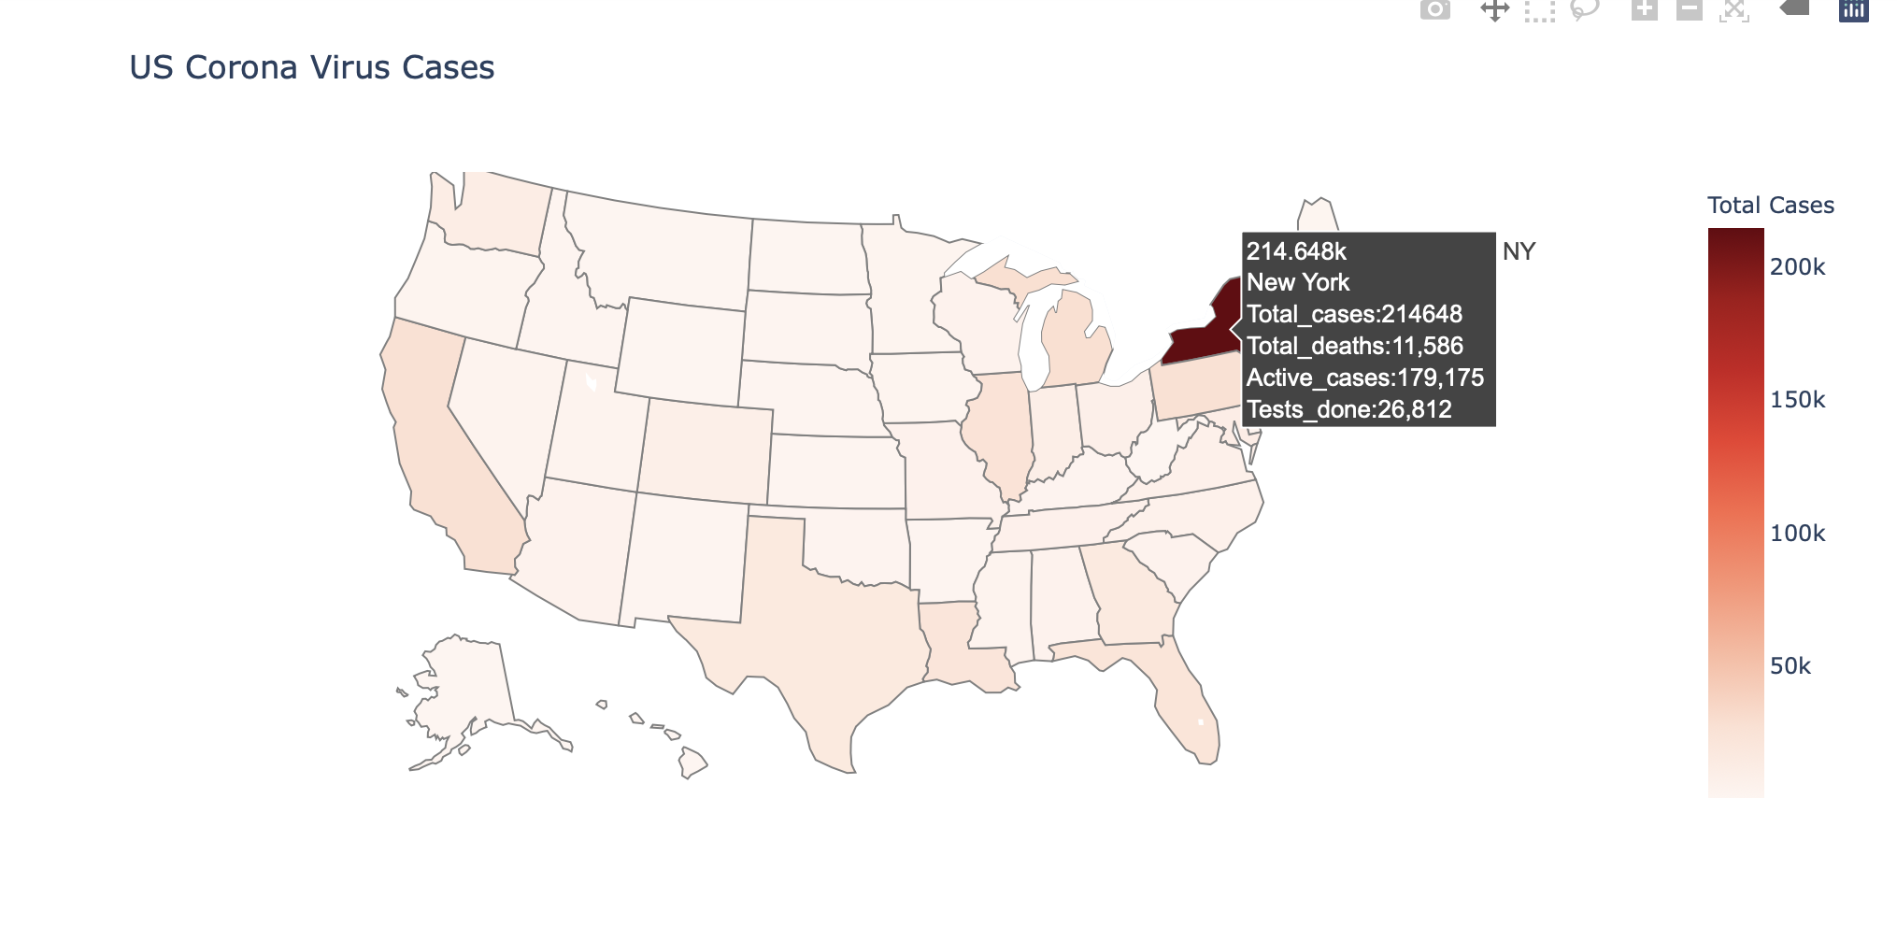
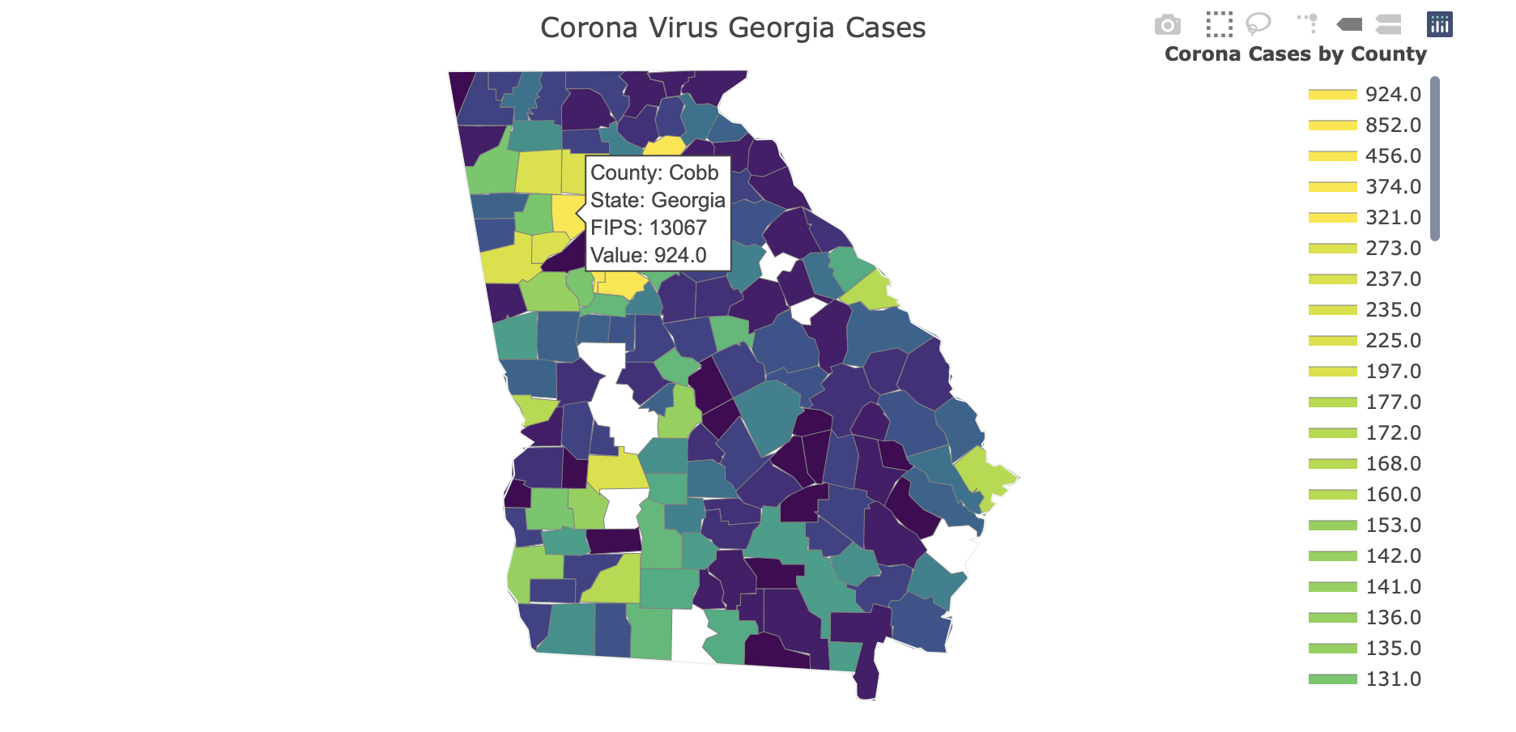
Results
Notes:
We got shortest path using both algorithms. These are some visualizations showing the safest path. We also presented few things like number of cases in each state of US and shown number of cases in each county of Georgia. Finally gave safest path between counties within Atlanta.

Slide 17
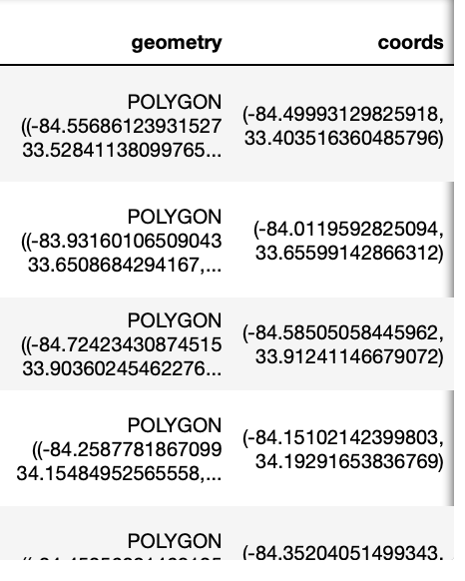
Technology Stack
PYTHON
JUPYTER NOTEBOOK
Deque
Pandas
VISUALIZATIONS
Shape files
Geopandas
Fips
Plotly
Matplotlib
Notes:
We used python and jupyter notebook. Deque is used to implement algorithms which already explained by Avinash. Deque is a list like container with fast appends and pops on either end.
For Visualizations
We used shape files of atlanta. Shape files have geographical data like polygons, linestrings that represents county boundaries, roads respectively using latitude and longitudes.
In order to visually present this data, we need geopandas which is an opensource like pandas. Pandas datatypes cannot work on spatial data. Geopandas will allow spatial operations.
This is how geopandas dataframe look like.
We have used plotly, matplotlib for plotting figures. Fips codes will uniquely identify counties. While merging number of cases data with geographical data we used these codes instead of county names.

Slide 18
Future Scope
Extend this by including all other states and countries.
Implementation with live data.
REST service for fetching time information.
Collecting more data on roads and intersections.
Improving Dijkstra's algorithm by starting at each end and expand both sides until they meet in the middle.
Regions with travel restrictions
Notes:
Here we find safest path within Atlanta as we don’t get enough data. We can extend this by including other states and countries.
We didn’t find any sources to update corona cases data hourly. They will update once a day. So we just used past data.
For now we have considered the time information by looking up google maps. We intend to implement a REST service that can hit maps API and fetch time information.
If we have data regarding street names, intersections we can give exact safest path.
Here we used dijkstras algorithm which will start from source. We can make few modifications like starting algorithm from each end source and destination and stop when they meet in middle.
We also can implement both the algorithms with travel restrictions on the regions. The algorithms should suggest path avoiding those regions
Rest of the slides will be continued by sameera.

Slide 19
References
An Improved Location-allocation Model for Emergency Logistics Network Design, Ming Liu and Yingzu Li IEEE 2018 8th International Conference on Logistics, Informatics and Service Sciences (LISS)
Extracting optimal paths from roadmaps for motion planning, Jinsuck Kim Roger A. Pearce Nancy M. Amato, 2003 Proceedings - IEEE International Conference on Robotics and Automation 2:2424 - 2429 vol.2
https://dev.to/mxl/dijkstras-algorithm-in-python-algorithms-for-beginners-dkc
https://www.edureka.co/blog/a-search-algorithm/
https://towardsdatascience.com/geopandas-101-plot-any-data-with-a-latitude-and-longitude-on-a-map-98e01944b972
https://github.com/CSSEGISandData/COVID -19/tree/master/csse_covid_19_data/csse_covid_19_daily_reports
Notes:
We have referred to few papers and internet journals to successfully implement our project

Slide 20
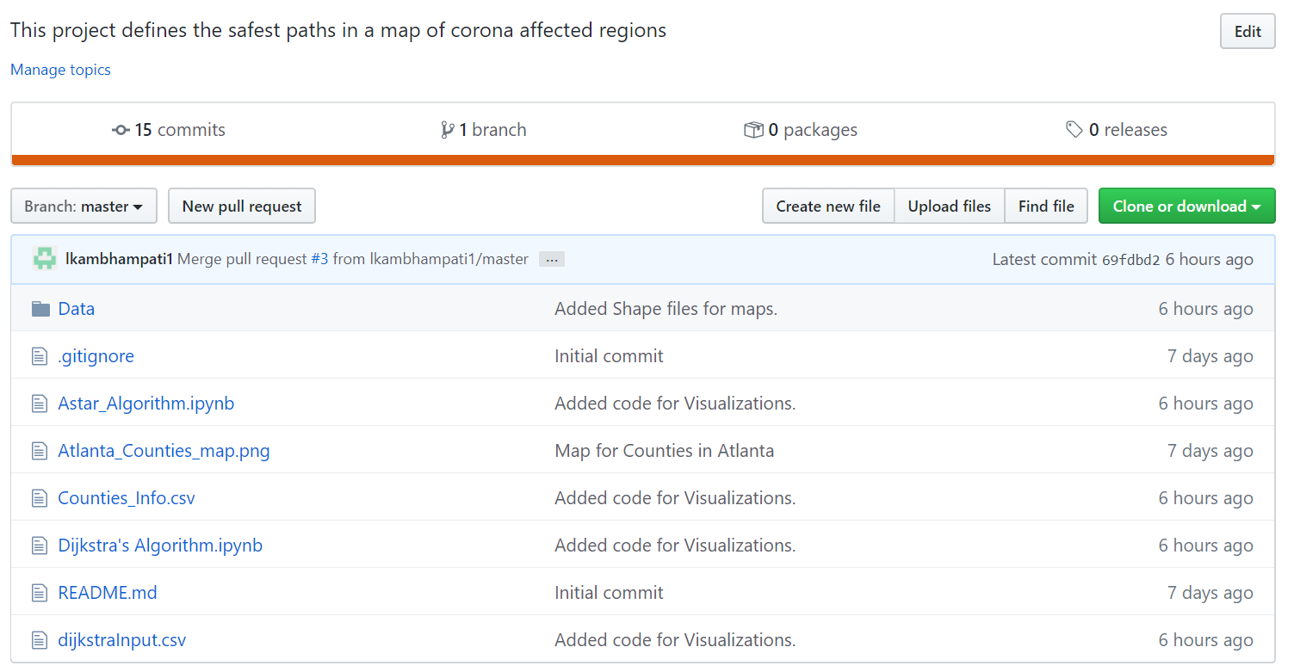
Collaboration
Notes:
We have used git as a version control system for collaboration and revisioning

Slide 21
Thank you

